Slide 1

Introduction to the
NEW JERSEY 9-1-1 Network
OFFICE OF EMERGENCY TELECOMMUNICATIONS SERVICES

Slide 2

Historical Overview
Worldwide
  Concept began in 1937 in England
United States
  Lengthy process began in 1958
  First 9-1-1 call in the United States was made in Haleyville Alabama in1968
Notes:
The concept of an easy to remember “short” number is not new. Great Britain initiated “9-9-9” service in 1937 nationwide. There was no location information it simply connected the caller to the local police station.
Americans stationed there during World War II brought the idea back after the war and tried to implement it in the U.S.A. It proved difficult because of the way the telephone network was set up. Some cities already had a “short” number for emergency services. Some places had a different number for each emergency service. Part of the discussion was which numbers to use. Both the International Association of Chiefs of Police and the International Fire Chiefs Association recommended this service in 1958 but it took several years before the first 9-1-1 network was created in Haleyville Alabama in 1968.

Slide 3


Historical Overview
New Jersey
  1st municipal 9-1-1 service was in Atlantic City in1972
  1st county 9-1-1 service was in Hunterdon County in 1977
  1989 required implementation of statewide E9-1-1
  E9-1-1 first implemented in1991 in Gloucester County
  Phase II Wireless 2007
  Text to 9-1-1 2017
Notes:
The first place in New Jersey was Atlantic City in 1972 and the first county was Hunterdon County in 1977. These networks did not provide location information. Implementation of a statewide “enhanced” 9-1-1 network occurred in 1989. This would provide the routing the call based on the caller’s location and provide the caller’s location information.
The first place to go live with this was Gloucester County in October 1991. E9-1-1 was available statewide in November 1993.
Mobile phones became popular in the 1980’s and the question of how to provide 9-1-1 service was asked. Location could not be used so routing based on the cell tower processing the call was used. The caller’s phone number and location were not available so the service acted like the original 9-1-1 service of 1972. In the 1990s cell calls were being routed to PSAPs based on the location of the tower receiving the call. By 2005 the ability to located the caller with some degree of accuracy was introduced.
In 2016 “Text to 9-1-1” was introduced in New Jersey. And in 2017 the process to replace the original 9-1-1 network with the “Next Generation” 9-1-1 was started.

Slide 4
HISTORICAL OVERVIEW
What factors would influence the number chosen as an emergency service number?
  Number is not already in use
  Number is easy to remember
  Would it have been better to use different numbers for each type of emergency service? (9-1-1 for Police, 9-2-2 for Fire and 9-3-3 for Medical).
Notes:
If you “google” 9-1-1 there are different stories about why the number 9-1-1 was used. Which one do you think is correct?
If cell calls are routed based on the cell tower receiving the call and not the caller’s location why do some PSAPs send units to check the area of the cell tower on hang-up?
Would it have been better to use different numbers for each type of emergency service? (9-1-1 for Police, 9-2-2 for Fire and 9-3-3 for Medical).

Slide 5

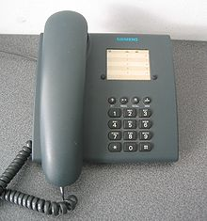
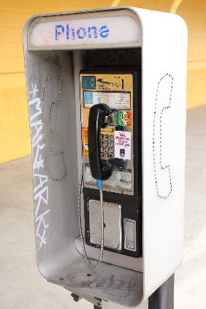
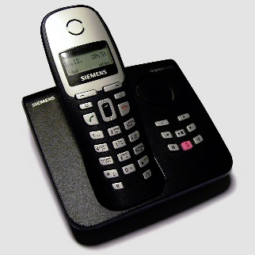
Benefits of 9-1-1
Benefits to the public
  Speed and convenience
  No need to remember several different 10-digit numbers
  Help can be sent even if the caller can’t speak
  No need to decide which service to call
  Free call from all telephones
  Instructions for CPR, choking and childbirth can be offered
Notes:
Prior to 9-1-1 service it was not unusual to have a phone number for the police, one for the fire department and another for the ambulance. Now this didn’t mean that if you called the police to report a fire you would not get the fire department but it could delay them somewhat. If you were visiting someone or traveling and had to stop to use a payphone (ancient technology) to report an emergency (pre-cell phone) and didn’t know where you were or what phone number to call then you would probably dial “O” for operator. And if the operator was not local and did not know the area any better than you, this could result in a significant delay.
9-1-1 allowed the call to be sent to the correct PSAP who would be familiar with the area and would be able to determine where you are. And E9-1-1 would provide the location of the phone.

Slide 6
Benefits of 9-1-1
Benefits to emergency responders:
  Location information
  Dispatch of aid even on hang-up or disconnected calls
  Call details can be stored in memory or printed for follow-up investigation or enforcement action
Notes:
With the location provided on the ALI screen the PSAP could send help even if the caller could not speak or was unable to speak, hung up or was forced to hang up or the fire burned through the wires (movie plot device).
On a “landline” call the ALI screen will provide the PSAP with the address of the caller, the callback number and the name of the service subscriber (not always the caller). This can help speed up the interrogation process however the caller may have moved recently and the record not yet updated. Always remember to verify the information with the caller.
If the caller cannot or is not able to speak to verify the location then the person taking the call will have to use the ALI screen information as the only source. This is the only time the ALI screen information should be used without verification.
While a cell phone will not provide an address for the caller it will route to a local PSAP who should be able to determine the caller’s location if they do not know.
The network shows when the call was received, offered to the PSAP, answered, when transferred, ended and other details. This information is stored in the memory of the newer computer based equipment or printed out in the older style. This can be obtained for investigations or employee performance evaluation.

Slide 7
Benefits of 9-1-1
Benefits to telecommunicators:
  Rapid access to dispatch points and other PSAPs
  Initial interrogation is expedited because ANI and ALI are delivered with the call.
Notes:
On the ALI screen there are 3 transfer options offered. For landline calls these are Police, Fire and EMS. If the PSAP does not provide one or more of these services they can quickly transfer the call by using these functions. In addition if the caller is reporting something that is in another PSAP’s jurisdiction the call can be transferred to the correct PSAP with the ANI/ALI information.

Slide 8
Benefits of 9-1-1
  Why is it not a good practice to except the ALI information without verifying it with the caller?
  Wireless calls display the cell tower location not the caller. Why are the calls routed to a local PSAP and not one for the entire state?
  Is it better to verify the ALI information by reading it back to the caller or asking them for their location, callback number and name?
Notes:
A great deal of time and effort have been put into creating the ALI database. Could a PSAP simply use the information displayed without asking the caller where the emergency was?
In some areas wireless 9-1-1 calls were sent to a single PSAP when there was no way to determine the caller’s location except by asking them. Since the implementation of ability to determine the caller’s approximate location PSAPs have asked to have then calls routed to them. Why would this seem to be a better method.

Slide 9

New Jersey’s 9-1-1 Organizational Structure
State Level:
  NJ Public Safety Communications Commission
  Office of Emergency Telecommunications Services (OETS)
Notes:
The original legislation that established E9-1-1 for New Jersey also created the “9-1-1 Commission” to oversee the planning, design and implementation of the statewide 9-1-1 network. This organization has evolved into the New Jersey Public Safety Communications Commission. This group now oversees 9-1-1 as well as the planning, design and implementation of the interoperable communications initiative for the state.
The Office of Emergency Telecommunication Services (OETS) serves the Commission by monitoring training, public education, technical developments and PSAP standards.
OETS established and maintains the State 9-1-1 plan by compiling the county and municipal 9-1-1 plans developed by the county and local coordinators. It sees that the technical and operational standards for PSAPs set by the Commission are met before joining the network and conducts periodic inspections to ensure compliance. It coordinates the training and certification of telecommunicators with the PSAPs and develops public education programs to increase the public’s knowledge of 9-1-1.

Slide 10

New Jersey’s 9-1-1 Organizational Structure
Telephone Companies
Pay Telephone Companies
Wireless Carriers
  Voice over Internet Providers (VoIP)
Notes:
At the start there were 3 companies providing telephone service in New Jersey. Over the years this has changed enormously. OETS works with each of the companies providing telecommuncation services, wireline, wireless, VoIP and texting with connection to the 9-1-1 network and in the routing of customer calls to 9-1-1.

Slide 11
New Jersey’s 9-1-1 Organizational Structure
Verizon Services:
9-1-1 Service Management
9-1-1 Customer Care Center
Database Management Center (DMC)
Notes:
New Jersey E9-1-1 is a statewide network. In most parts of the county 9-1-1 networks are set up at the county or municipal level. Many chose to manage the database and network at their level. Because of the complexity of a statewide network New Jersey has contracted Verizon to provide E9-1-1 service. This includes all of the physical components that get the calls to the PSAPs, the Emergency Service Number (ESN) programing and the database. The ESN will be covered in another section.
The 9-1-1 Customer Care Center (formerly the 9-1-1 Control Center) is the point of contact whenever a PSAP has a problem with the network. Lost data links, circuits, unreadable ALI screens, 9-1-1 calls from unusual places, reports that 9-1-1 calls to your PSAP are not being answered are just some of the things that should be reported to CCC at (800) 773-7911.
The Verizon Database Management Center is what gets 9-1-1 calls to the proper PSAP. They coordinate the records from all of the telephone service providers for customers in New Jersey. However they cannot make changes to other provider’s records. With the vast number of telephone service providers now it is important that whenever a correction has to be made to the ALI screen it is sent to the proper database manager. Today many VoIP service providers maintain their own database records and are not provided to Verizon. The information on the Ali screen is provided by the VoIP service and not Verizon’s database.

Slide 12
New Jersey’s 9-1-1 Organizational Structure
9-1-1 Equipment Vendors
must receive approval from OETS.
Notes:
Each PSAP and PSDP can select their own provider of 9-1-1 telephone equipment. OETS reviews these products and which are approved for connection to the network.
When new 9-1-1 telephone equipment is installed OETS will visit the facility to ensure that it is properly configured to meet the regulations.

Slide 13
New Jersey’s 9-1-1 Organizational Structure
County Government
  Coordinate 9-1-1 activities
  Formulate and maintain the county 9-1-1 plan
  Work with municipalities and telephone companies to maintain the Master Street Address Guide (MSAG)
Notes:
Each county is required to appoint a County 9-1-1 Coordinator. Their job is to create and maintain the County 9-1-1 Plan and to maintain the 9-1-1 Master Street Address Guide (MSAG). The plan includes each municipality, their primary PSAP, secondary PSAPs (if any), PSAP equipment, PSAP contacts and any information needed in the county plan. The MSAG can be maintained with help from the Local 9-1-1 Coordinator.

Slide 14
New Jersey’s 9-1-1 Organizational Structure
Municipal Government
  Provide data required to maintain the MSAG
  Develop and maintain the municipal 9-1-1 plan
  Serve as point of contact for agency 9-1-1 issues
Notes:
Each municipality is to appoint a Local 9-1-1 Coordinator to provide PSAP and MSAG information to the County 9-1-1 Coordinator in the form of the Local 9-1-1 Plan.
These plans are what make up the State 9-1-1 Plan.

Slide 15
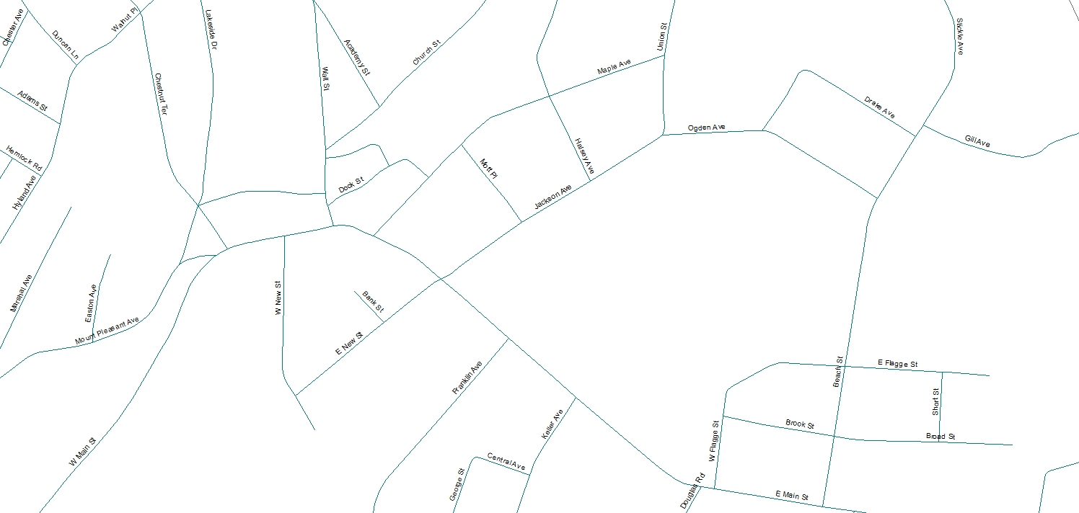
Police 1
Fire 2
ESZ 3
Police 1
Fire 2
EMS 1
EMS 2
ESZ 2
Police 1
Fire 2
EMS 2
EMS 1
ESZ 4
Police 1
Fire 3
EMS 1
Fire 3
ESZ 1
Police 1
Fire 1
EMS 1
Fire 1
Notes:
To explain what an MSAG is in the beginning (1989) each County Coordinator was given paper maps of each municipality. Working with the Local 9-1-1 Coordinator the division of emergency services for each town was established. To do this lineswere drawn to show the area covered by the local police department. In most cases this was the whole town so there was 1 police area. Next the fire company areas were drawn. There could be a single fire company or several. Each fire company area was numbered. Finally each EMS area was drawn and numbered. Each area with a unique combination of police, fire and medical organizations was assigned a number referred to as an Emergency Service Zone (ESZ).

Slide 16
ESZ 3
Police 1
Fire 2
EMS 1
1-399
2-498 EVEN
Mt Pleasant Ave
Maple Ter
ESZ 2
Police 1
Fire 2
EMS 2
400-899
Maine St
400-499
1-699 ODD
E New St
500-799
500-699
ESZ 1
Police 1
Fire 1
EMS 1
502-698 EVEN
Notes:
The name of each street on the map had to be verified and the address range, (lowest number to highest number) the street segment in each ESZ had to be displayed on the map. Each ESZ was then assigned a unique Emergency Service Number (ESN) to use in the MSAG.

Slide 17
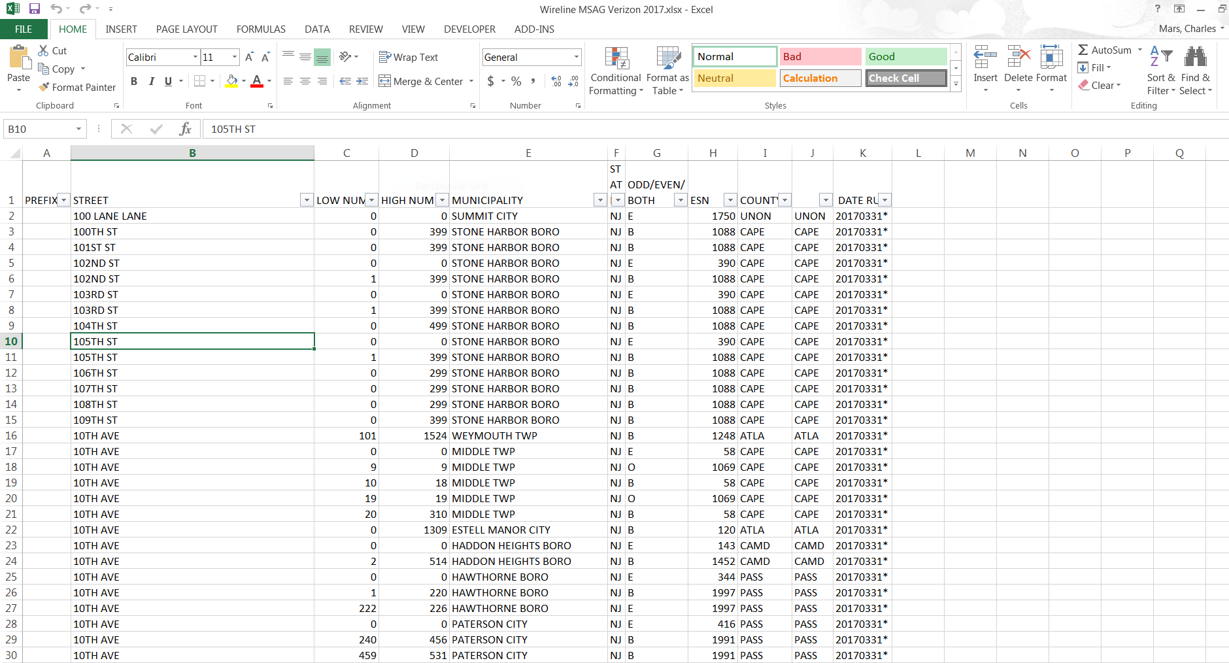
Notes:
Today there is no need to use the maps. Any changes to the MSAG can be submitted to Verizon using the forms provided.

Slide 18
New Jersey’s 9-1-1 Organizational Structure
Public Safety Answering Points (PSAPs)
  Must meet equipment and training standards established in the NJ 9-1-1 regulations
Public Safety Dispatch Points (PSDPs)
Notes:
Public Safety Answering Points (PSAPs) may be called a Primary PSAP because they are the first to get the 9-1-1 call. An agency that does not get the initial call but has the caller transferred to them is the Public Safety Dispatch Point (PSDP) because their job is to send the proper emergency services. These can also be called a Secondary PSAP.
The Primary PSAP must have all of the equipment, training and staffing required by the state regulations. PSDPs do not. The equipment, training and staffing are up the local authorities. However, if they provide Emergency Medical Dispatch (EMD) Service their training must include EMD certification.

Slide 19
New Jersey’s 9-1-1 Organizational Structure
Why is it important that all types of telephone service providers maintain the ALI Database?
Who should the PSAP contact when they have a problem with calls routing to the wrong PSAP, training questions, difficulty finding a service provider, new technology, etc.?
Notes:
In order to make 9-1-1 work all of the components have to be in place. If the service providers do not correctly set up the ALI information 9-1-1 calls will not know which PSAP to go to.
Any questions about the 9-1-1 network can be directed to OETS.

Slide 20
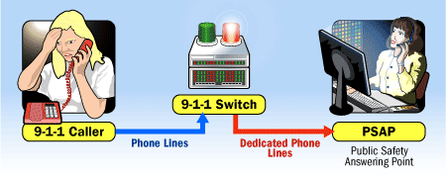
Differences Between Basic and Enhanced 9-1-1
Basic 9-1-1
  No ALI, in some cases no ANI
  No Selective call routing, calls route based on telephone service area
Notes:
With Basic 9-1-1 there is no location and there may not be a call back number. The call routes based on the telephone company service area so the PSAP may not be one that serves the caller’s location.

Slide 21
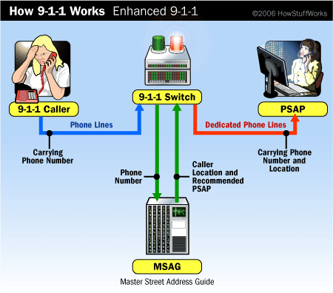
Differences Between Basic and Enhanced 9-1-1
Wireline Call Routing
Enhanced 9-1-1
  Selective call routing
  ANI & ALI
ANI
ALI
ALI Database
Notes:
With Enhanced 9-1-1 the call is routed to the proper Primary PSAP using the ESNs, MSAG and all of the resources of the network. ANI and ALI information are provided to the PSAP. The only time it does work is if there is no dial tone available to the caller (no phone service) or the central office is isolated from the public telephone network.

Slide 22
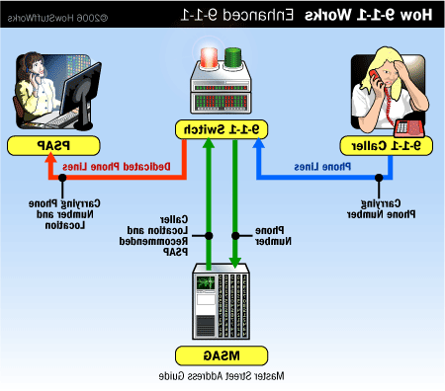
Differences Between Basic and Enhanced 9-1-1
Wireline Call Routing
Selective call routing
Central Office covering Town A and Town B
Town A
ESN 0123
Town A PSAP
Town B PSAP
Town B
ESN 0321
Basic 9-1-1 Call Routing
Enhanced 9-1-1 Call Routing
Notes:
In this example two towns sharing the same central office (red line) will have 9-1-1 calls routed to only one PSAP using Basic 9-1-1. When Enhanced 9-1-1 is implemented the routing will be based on the caller’s location even though the calls go through the same central office (green line).

Slide 23
Differences Between Basic and Enhanced 9-1-1
Possible wire line 9-1-1call delivery problems:
  No dial tone because the telephone or the lines to the central office are out of service
  The central office is isolated from the telephone system and unable to pass the call to the 9-1-1 network
Notes:
If the caller does not get a dial tone then there is no phone service available. If the central office is isolated then they may get a busy signal.
If a wireless phone cannot get a signal or if the signal is not strong enough then they may not be able to make a call to 9-1-1 or anyone else. It is possible that a text message may be sent because data seems to work over low strength connections.

Slide 24
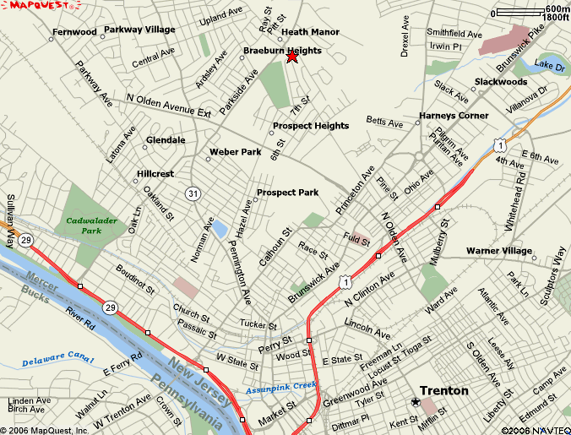


Differences Between Basic and Enhanced 9-1-1
Wireless Call Routing
  Based on the cell tower receiving the call.
  Phone location is available after call is answered.
Notes:
Wireless or cell phone routing cannot presently be based on the phone location like wireline. The call is routed based on the cell tower receiving the call. Once the PSAP has answered it may be able to obtain the callers location from the caller. In addition the network may be able to offer an approximate location in the form of the latitude and longitude of the phone.

Slide 25
Differences Between Basic and Enhanced 9-1-1
VoIP Call Routing
  Stationary
    Same as Wireline
  Nomadic
    Customer provided address is used to determine latitude and longitude.
  Mobile
Notes:
Voice over Internet Protocol (VoIP) can be routed in different ways. One form called Stationary works the same as wireline routing using the MSAG. These phones remain in one place let a wireline phone. VoIP service that can be taken to another location and used is called Nomadic. To make this work the provider can use a combination of the MSAG and latitude and longitude based on the phone location. The customer is required to go online and update the new location of the phone when it is reconnected to the internet. The VoIP provider then may use the MSAG or the latitude and longitude obtained from a third party provider to route the 9-1-1 call. Problems have occurred when the VoIP provider uses the Post Office instead of the name of the municipality to select the ESN for routing. They may also chose the wrong town when the name is used more than once (ex. Washington, Hamilton, etc.) or when the Post Office name is not an actual town but a local name (ex. Blackwood, Titusville, Vauxhall, etc.).

Slide 26
Differences Between Basic and Enhanced 9-1-1
Text to 9-1-1 Call Routing
  Routed at the County Level
    By cell tower receiving message.
    Based on the latitude and longitude of the device.
Notes:
The interim solution that was used to provide texting to New Jersey established routing at the county level. Depending on the device used and the service provider some will route based on the device location, others on the cell tower processing the text message similar to wireless calls.

Slide 27
Differences Between Basic and Enhanced 9-1-1
Why is it important
Notes:
In order to make 9-1-1 work all of the components have to be in place. If the service providers do not correctly set up the ALI information 9-1-1 calls will not know which PSAP to go to.
Any questions about the 9-1-1 network can be directed to OETS.

Slide 28
Wireless 9-1-1
Phase 0
  Calls rarely routed to the appropriate PSAP
  No ANI
  No ALI
Notes:
Phase 0
At first 9-1-1 was not available on wireless phones. There was no way to tell where the call was being made to determine where the call be routed to. There were some attempts to route based on the cell tower but these did not display any ANI or ALI information.
As providers began to offer 9-1-1 service the routing was based at the county level. A large PSAP was selected for each county and the calls routed there. The PSAP would have to determine the caller’s location and if they did not dispatch emergency services for there then relay the information to the proper PSAP. In some counties New Jersey State Police were the PSAPs.

Slide 29
Wireless 9-1-1
Phase 1
  Calls are directed to an appropriate PSAP
  Cell tower location provided
  Caller’s telephone number provided
  No caller location information provided
Notes:
Phase I
With Phase I ANI information was available. An MSAG was created for the cell towers. Each would be entered with a specific address and a direction indicating the coverage area of the antenna receiving the call. Each was given a unique set of “routing digits” that would be used to send the caller to the PSAP. This allowed the calls to be directed to a local PSAP although there was still no guarantee that the caller was in their jurisdiction. The 9-1-1 network could now request ALI information based on the routing digits and get the location of the cell tower from the MSAG and the caller’s phone number. Still no location of the caller other than what they told the calltaker.

Slide 30
Wireless 9-1-1: WPH 1
*WRLS PH2* LAT/LONG NOT AVAILABLE 609-783-4216 09:30:34 02-08-05
CINGULAR WIRELESS
0000000655 ABSECON
BLVD SE
RADIUS 04 MILES
ATLANTIC CITY XX
+039.371060 –074.430250
UNC: % WPH1
ESRD # 609-511-6545 ESN 5935
ATLANTIC CITY PD
F1=EGG HRBR CITY 609 235-1000
F2=PLEASANTVIL 609 933-0555
F3=AC EXPRESSWAY 609 969-3128
LEC CNGLR
Class of service:
Alerts that the location information pertains to the cell tower, not the caller’s location
ALI Caution Line:
Advises call is capable of Phase 2 but arrived Phase 1
Notes:
When Phase II was activated it was still possible to receive a wireless call and not get the caller’s estimated location. In the example shown the service provider does not yet have the location of the caller. The first indication is the top of the ALI screen known as the “Warning Line” *WRLS PH2 LAT/LONG NOT AVAILABLE* means that while the provider is able to determine the estimated location of the caller it has not yet received enough information to offer the location. The other indication is in the “CLASS OF SERVICE” (COS) field on the right side of the screen. This shows “WPH1” indicating that the latitude and longitude is that of the cell tower.

Slide 31
Wireless 9-1-1
Wireless Phase 2
  All Phase 1 information
  Location of the caller is delivered in the form of a latitude and longitude with a specified degree of accuracy
  Required modifications to both the 9-1-1 and wireless networks
Notes:
Phase II
When the service provider is offering Phase II information it will include the Phase I callback number, name of the service provider and the address of the cell tower. Now the latitude and longitude will be the estimated location of the caller with the estimated degree of uncertainty.

Slide 32
Wireless 9-1-1: WPH2
Call arrived with Phase 2 information
*WRLS PH2* 609-783-4216 09:30:34 02-08-05
CINGULAR WIRELESS
0000000655 ABSECON
BLVD SE
RADIUS 04 MILES
ATLANTIC CITY XX
+039.365560 –074.424450
00000100 67% WPH2
ESRD # 609-511-6545 ESN 5935
ATLANTIC CITY PD
F1=EGG HRBR CITY 609 235-1000
F2=PLEASANTVIL 609 933-0555
F3=AC EXPRESSWAY 609 969-3128
LEC CNGLR
Location information for the cell tower processing the call
Name of Wireless service provider
Class of Service: Now indicates that the Latitude and Longitude relate to the caller’s location, not the cell tower.
Latitude and Longitude of the caller
Notes:
On the ALI screen the “WARNING LINE” will display *WRLS PH2* and the COS will display “WPH2”. The latitude and longitude will be the caller’s location and next line indicates within how many meters of that position the caller may be and the percentage of accuracy.

Slide 33

Wireless 9-1-1: WPH2
9-1-1 Tandem/ Selective Router
(SR)
PSAP
Mobile Switching Center MSC)
Voice, Call Back Number (CBN) & ESRD
CBN
and ESRD
Mobile
Position
Center
(MPC)
Emergency
Services
Message
Entity
(ESME)
[Intrado, TCS]
New Jersey’s
ALI Database
x,y coordinates
x
y
Position
Determining Equipment
(PDE)
Wireless Network
9-1-1 Network
Notes:
The routing diagram shows the voice call going to the 9-1-1 network and being delivered to the PSAP based on the routing of the cell tower antenna. While this is happening the service provider is also trying to determine the location of the device from the Position Determining Equipment which is then sent to the Mobile Positioning Center. When the PSAP answers the 9-1-1 call their equipment sends the request to the 9-1-1 network for the information about the call. The network identifies that it is a cell call and sends the query to the Emergency Services Message Entity which then sends the information from the MPC to the PSAP. If the MPC does not have Phase II information the ALI screen will have the warning *WRLS PH2 LAT/LONG NOT AVAILABLE* and the CLS will be WPH1. If it has the Phase II information it will display as *WRLS PH2* and WHP2.
If the ALI screen is Phase I the PSAP can request an update by manually sending an ALI query to the network. Each PSAP has this ability however the manufacturers of the telephone equipment each have a different name for this function. It may be called “Rebid”, “Send ALI”, “ALI”, “Query ALI”, “Resend ALI” of something else. Check with the person responsible for maintaining your telephone equipment if you do not know.

Slide 34
Wireless 9-1-1
Why is it important
Notes:
E9-1-1 was designed to work with telephones that did not move. When wireless phones were introduced there was no accurate way to route a 9-1-1 call based on the phone’s location. Why do you think 9-1-1 service was offered under these conditions?
What methods can be used to determine the location of a wireless caller?

Slide 35
VoIP 9-1-1
Voice over Internet Protocol (VoIP) telephone service is the newest telecommunications technology to impact on 9-1-1 service. There are three types of VoIP service:
Notes:
Voice over Internet Protocol (VoIP) telephone service is the newest telecommunications technology to impact on 9-1-1 service. In many ways it looks and acts just like traditional telephone service but there are differences.
Presently there are three types of VoIP service

Slide 36
VoIP 9-1-1
Stationary: Users with this type of VoIP connection the users cannot move their phone service. The location of the VoIP phone does not change.
908-783-4216 09:30:34 02-08-13
FLANNAGAN ROBERT
0000000203 FLOCKTOWN
ROAD
WASHINGTON TWP NJ
APT FLR RESD
PILOT# 908-783-4216 ESN 1298
MORRIS COUNTY COMM CTR 973
WASHINGTON TWP PD 908 876-3232
WASH TWP FD STA35 908 876-3232
LONG VALLEY FA 908 876-3232
LEC CMST
Notes:
The stationary VoIP service resembles landline telephone service The ALI screen may look the same. The service remains in one place.

Slide 37

VoIP 9-1-1
Nomadic: This type of service allows the user to take their phone service with them where ever they have a broadband connection they can plug into. The location of the VoIP phone can change from call to call but not during a call.
*VOIP VPC CALL* 908-783-4216 09:30:34 02-08-05
FLANIGAN ROBERT
0000000203 FLOCKTOWN
ROAD
WASHINGTON TWP NT
+039.919531 –075.095522
UNC: % VOIP
ESRD # 908-211-6545 ESN 0694
MORRIS COUNTY COMM CTR 973 WASHINGTON TWP PD 908 876-3232 WASH TWP FD STA 36 908 876-3232 LONG VALLEY FA 908 876-3232
LEC VNTG
Notes:
Nomadic VoIP service can be used anywhere the user can get connection to the internet. Many services require the user to update their location each time they reconnect so that 9-1-1 calls can be routed properly. If the wrong address is entered 9-1-1 calls can route to the wrong PSAP.

Slide 38
VoIP 9-1-1
Mobile: The subscriber to this service connects to the Internet by means of a Wi-Fi or other technology that allows the user to travel during the call. The location of the VoIP phone can change during the call.
Notes:
VoIP providers are offering customers the ability to use their mobile devices with their service using Wi-Fi connections. Routing 9-1-1 calls while doing this can result in errors as the device has no fixed address. Routing may sometimes be done using the billing address.

Slide 39
NJ 9-1-1 –
Special Features
Selective Transfers
  Transfers are based on the ESN for the call being received
  Special ESNs are created for routing and transferring wireless calls
  Access to a specific combination of dispatch agencies or PSAPs
  Keys Labeled: F1-Police, F-2-Fire, F3-Medical
Notes:
Selective Transfers are a feature of the New Jersey 9-1-1 Network. In 9-1-1 there are three primary services, police fire and medical but who dispatches these can vary. If a PSAP dispatches police, fire and medical services then there is not much need for the transfers on wireline calls. But a PSAP may not dispatch anyone. They answer, “9-1-1, where’s your emergency?” Once they determine the location and nature of the emergency they need to transfer it to the proper PSDP. The selective transfers make this easy. And if the PSDP has 9-1-1 equipment they will get the ANI/ALI information along with the caller. If the primary PSAP is busy and the call is answered by another PSAP, once they determine the location and nature of the emergency they can easily transfer to the proper PSDP.
In the days of wireline only 9-1-1 these transfers were referred to as “Police”, “Fire” and “EMS” since they were always the options. With wireless this changed.
Because of the problems with routing wireless calls and the possibility that the caller may not be in your jurisdiction instead of offering a police a fire and a medical transfer it was decided to offer three other nearby PSAPs where the caller might be. On wireless ALI screens they are marked “F1”, “F2” and “F3” followed by the names of these PSAPs. So, if the call is yours and it’s medical in nature do not press the EMS button to transfer it. It will go to another PSAP not the ambulance.

Slide 40
NJ 9-1-1 –
Special Features
856-783-7626 10:30:34 02-08-06
MAYER OTTO H
000604 CUMBERLAND ST S
MAGNOLIA BORO NJ
FLR RESD
PILOT # 856-783-7626 ESN 0182
CAMDEN COUNTY COMM CENTER
MAGNOLIA PD 856-783-4900
MAGNOLIA FD 856-783-4444
MAGNOLIA EMS 856-783-4444
LEC VERZN
*WRLS PH2*
609-789-2345 09:21:14 02-08-05
VERIZON WIRELESS
0000000088 DENNISVILLE
RD NE
RADIUS 05 MILES
MIDDLE TWP XX
+039.103440 –074.802620 +00000
UNC: 0000150 90% WPH2
ESRD # 609-511-4000 ESN 5404
NJSP OUD-SOUTH COMM 4
F1=GS PKY BASS RVR 609 295-2031
F2=MIDDLE TWP PSAP 609 465-8700
F3=LOWER TWP PSAP 609 886-2711
LEC VRZWL
F-1
Police
F-2
Fire
F-3
EMS
F-4
F-5
Poison
F-6
F-7
Redun
F-8
Non-Em
F-9
Notes:
In the days of wireline only 9-1-1 these transfers were referred to as “Police”, “Fire” and “EMS” since they were always the options. With wireless this changed.
Because of the problems with routing wireless calls and the possibility that the caller may not be in your jurisdiction instead of offering a police a fire and a medical transfer it was decided to offer three other nearby PSAPs where the caller might be. On wireless ALI screens they are marked “F1”, “F2” and “F3” followed by the names of these PSAPs. So, if the call is yours and it’s medical in nature do not press the EMS button to transfer it. It will go to another PSAP not the ambulance.

Slide 41
NJ 9-1-1 –
Special Features
Fixed transfers
  Do not change based upon the ESN
  PSAPs may have designated fixed transfers to facilitate call transfers to nearby PSAPs and PSDPs
  NJ 9-1-1 Transfer Directory contains 9-1-1 network transfer numbers for all NJ PSAPs and PSDPs
Notes:
Fixed Transfers do not change with the ESN. A PSAP or PSDP can maintain a list of PSAP transfers with Verizon using the “Speed Dial” function. The list is limited but the advantage is if a PSAP transfer number is changed Verizon will automatically update the Speed Dial for the PSAP/PSDP.
Because PSAP/PSDP numbers can change OETS maintains a PSAP Transfer Directory listing all PSAPs and PSDPs on the network and the Primary PSAP for each municipality. Updates are posted on a secure document library and access is available to all PSAPs and PSDPs. Updates can also be sent out upon request.

Slide 42
NJ 9-1-1 –
Special Features
Fixed transfers
  State required transfers:
    Poison Control
    Redundant Call
    Non Emergency Call
  Follow agency SOPs on the use of
  Redundant or Non Emergency Call
  transfers
F-1
Police
F-2
Fire
F-3
EMS
F-4
F-5
Poison
F-6
F-7
Redun
F-8
Non-Em
F-9
Notes:
There are three Fixed Transfers required by OETS. These do not appear on the ALI screen but are on the console or monitor screen of the 9-1-1 equipment. “Poison Control” will connect the caller to “poison control” (“Thanks Captain Obvious”) where the caller can receive information from the medical staff to help before the ambulance arrives. In some cases they can offer guidance to the ambulance or initiate certain treatments with the receiving hospital. In these cases the PSAP may want to stay on the call.
The “Redundant” and “Non-emergency call” transfers the caller to a recorded message indicating that the PSAP is aware of the emergency or that the call is not an emergency and the caller should look up the proper non-emergency number and call that. The PSAP can use these or if time permits simply explain it to the caller at their discretion.
Before using the “Redundant button” be sure that the call is reporting the same emergency you already have. How many times has a motor vehicle collision been caused when someone is driving by a collision that already occurred? Or more than one person passes out in the local park on a hot day?

Slide 43
NJ 9-1-1 –
Special Features
PSAP to PSAP transfers
  Allows transfer of caller along with ALI data
  Process:
    Advise caller they are being transferred
    Locate 10-digit transfer number
    Access 9-1-1 network dial tone
    Dial the 10-digit transfer number
    When answered at other PSAP/PSDP verify that appropriate transfer has been made
Notes:
When performing a “PSAP to PSAP (PSDP)” transfer first advise the caller that you are going to transfer them. If the transfer is not in the selected or fixed transfer lists you will have to dial the number manually. Many of the newer computer based systems have a phone book built in that can allow listing all of the PSAP and PSDP network transfer numbers. Callers can also be transferred to phone numbers that are not on the NJ 9-1-1 network. These calls will not include ANI/ALI information. Stay on the call until the other PSAP answers. Make sure that you have the correct PSAP that they are getting the ANI/ALI information and relay any information that you have obtained from the caller. Once this is completed the sending PSAP can disconnect.

Slide 44
NJ 9-1-1 –
Special Features
Alternate Routing
  Ability to direct calls to alternate PSAPs in the event of equipment malfunction or call overflow
  9-1-1 network is programmed to overflow calls after a pre-determined number of rings
Notes:
In many states the 9-1-1 network is built at the county or municipal level. When 9-1-1 calls go to the wrong PSAP they may not be able to transfer the caller with ANI/ALI information. The 9-1-1 network is statewide so every PSAP and PSDP (with ANI/ALI) is connected. A 9-1-1 caller in Cape May can be easily transferred to Hoboken if needed. Also when a PSAP is overwhelmed by incoming calls, or is without power or phone service the network will automatically redirect 9-1-1 calls to another PSAP without interruption.
Most of the time this will happen when the PSAP is receiving more calls than they have calltakers, such as an accident at a busy location. The calls will “ring” at the primary PSAP and if not answered (usually within 6 rings) the network will offer the call to the “overflow” PSAP. This PSAP will answer the call and may attempt to transfer back to the primary but if they are still busy then the call will go to another PSAP. It is recommended that PSAPs establish a plan of how to handle overflow calls from other PSAPs, should they transfer or take all of the information and relay it to the primary PSAP via radio or direct line or send their own units to the emergency.
A PSAP can have several overflows if they want but if an overflow goes from PSAP A to PSAP B then PSAP C to PSAP D it cannot go back to PSAP A. The pattern is limited and must be worked out with Verizon before they can be implemented.

Slide 45
Special Features
When a 9-1-1 call overflows to another PSAP why are the selective transfers important?
How can a PSAP transfer a call to a PSAP that is not on the ALI screen?

Slide 46
Equipment and Operational Standards
Standards for PSAPs and PSDPs are established in the State of New Jersey 9-1-1 Regulations [N.J.A.C.17:24]
Notes:
A primary PSAP is required to have certain equipment and operate under established standards by the State of New Jersey..

Slide 47
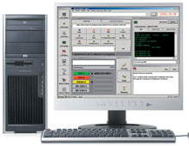
Equipment and Operational Standards
Call taker position equipment
  9-1-1 terminal
  Conference and transfer ability
  ALI screen
  Teletypewriter-TTY
Notes:
The 9-1-1 telephone terminal from an approved vendor. The equipment must be able to conference and transfer calls. It must display ANI and ALI information. And it must have the ability to communicate using a teletypewriter (TTY/TTD).

Slide 48
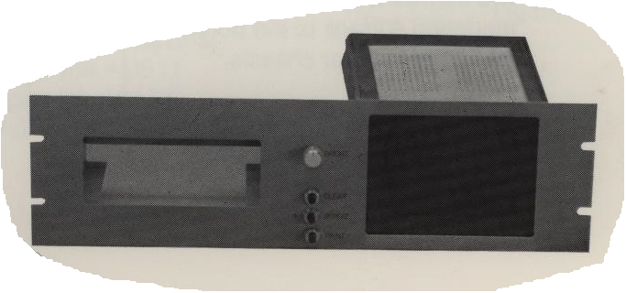
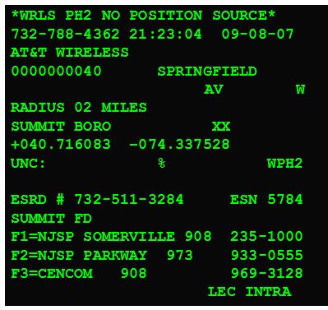
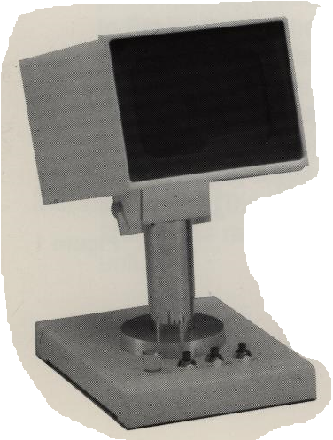
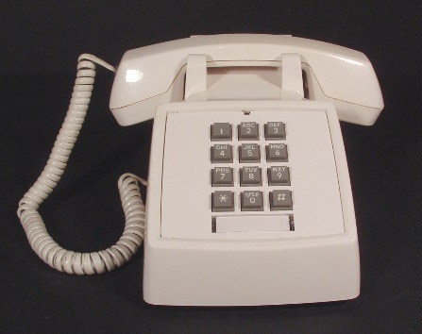
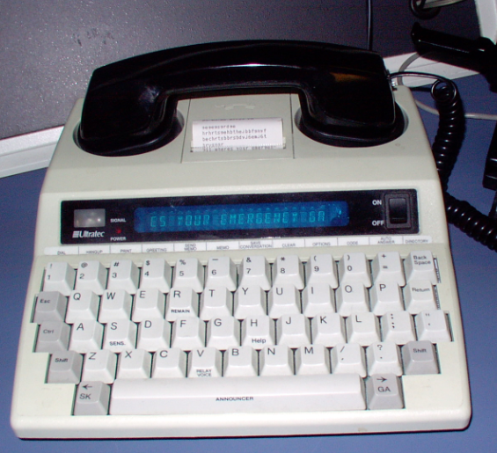
Equipment and Operational Standards
Call taker position equipment
  9-1-1 terminal
  Conference and transfer ability
  ALI screen
  Teletypewriter-TTY
Notes:
When E9-1-1 was implemented this was a panel with buttons and a small green computer screen to display the ALI. The TTY/TDD was a separate device. As these became computer workstations all of the functions were incorporated into the monitor screen with “buttons” to click on, a larger ALI screen (color optional) and a keyboard that could be used with the built in TTY/TDD.

Slide 49
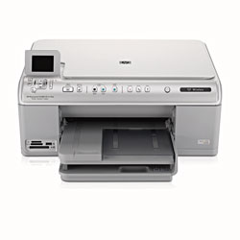
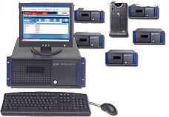

Equipment and Operational Standards
Required PSAP Equipment
  9-1-1 printer
  Instant playback recorders
  Logging recorder
  Uninterruptible Power supply
Notes:
PSAPs are required to have a printer to record each 9-1-1 call. The newer computer based equipment can store this information allowing the calltaker to retrieve it as needed thereby omitting the need for a printer. An instant playback recorder at the workstation that allows the calltaker to replay calls to verify or retrieve information after the call is terminated. A logging recorder that records all of the 9-1-1 workstations and/or circuits in the PSAP. While these were individual components they are now incorporated into most 9-1-1 workstations by the vendor. An uninterruptable power supply (batteries, lots of batteries) is required and each workstation or for the entire operation

Slide 50


Equipment and Operational Standards
Recommended PSAP Equipment
  Generators
  Lightning protection
  Recorder on radio channels
Notes:
It is recommended that the PSAP have electric generators in addition to the UPS. Lightning protection and recorder (instant playback or logger) are also recommendations, not requirements.

Slide 51
Equipment and Operational Standards
PSAP staffing standards
  Staff the PSAP 24/7
  Sufficient staffing to answer calls within 10 seconds
  Each call taker and dispatcher must be certified
  Translation services when required
  Each call taker and dispatcher must receive 8 hours of continuing education each year
Notes:
Staffing is required 24 hours a day. Seven days a week. The number of staff will vary depending on factors such as the population served and the number of 9-1-1 calls received. While it would be nice to have a calltaker for each call every time the more realistic goal is to be able to answer 90% of the calls within 10 seconds during the average busiest hour of the day. There is a formula for that. Maybe even an “app”.
In a primary PSAP each calltaker and dispatcher must be certified. If the PSAP does not provide Emergency Medical Dispatch service they only require Basic Telecommunicator certification. If the PSAP or PSDP provides EMS service they must also have Emergency Medical Dispatch certification. The PSAP or PSDP is to provide each calltaker/dispatcher with eight (8) hours of continuing education each year.
A PSDP that does not provide EMD service needs only the level of training required by the agency.
Translation services for voice calls may be required based on the population served by the PSAP/PSDP.

Slide 52
Equipment and Operational Standards
PSAP Operations
  Call answering
    All calls must be answered with a generic statement such as “9-1-1 where is the emergency?”
    No geographic or jurisdictional location should be mentioned
    No specific response agency should be mentioned
Notes:
The primary PSAP must answer a 9-1-1 call with a generic statement that does not identify the agency, service, geographic or jurisdictional area. “9-1-1, where is your emergency” is recommended. Callers may become confused if calling the local police and hearing the phone answered by a county agency. Or a fire call being answered by police.

Slide 53
Equipment and Operational Standards
Why should location or response agency information be omitted when answering 9-1-1 calls?
  Callers reaching a regional center may be confused hearing a locale other than where they are located
  Calls may be re-routed due to an overflow again confusing the caller
  The mention of a specific type of response agency may confuse the caller if that is not they service they need
Notes:
Can you think of any other reasons for not mentioning the location or response agency name?
Are there any times when you would want to offer this information?

Slide 54
Equipment and Operational Standards
Call Answering
  All 9-1-1 calls must be answered at the PSAP within ten seconds, except during the PSAP’s busy hour during which 10% can be answered in 20 seconds
  EMD pre-arrival instructions must be given whenever possible and practical
Notes:
It was mentioned that 90% of the calls had to be answered within 10 seconds. For that 10% that occur during the “busiest hour” the answer time is 20 seconds.
EMD pre-arrival instructions must be given “whenever possible and practical”. So during that “busiest hour” or other period of high call volume PSAP may not be able to provide pre-arrival instructions. Before this happens the PSAP should set a policy or procedure to address this issue.

Slide 55
Equipment and Operational Standards
Call transfers
  Appropriate transfer should be made within 20 seconds for 90% of all calls
  Exceptions:
    Non-English speaking caller
    TTY user
    Hang up call
Notes:
When it is necessary to transfer a call to another PSAP or PSDP it should be made within 20 seconds for 90% of the calls. This should give the calltaker time to verify the location and nature of the emergency and identify the destination of the transfer. There will be exceptions such as the caller does not speak English, is using a TTY/TDD, is a young child not sure of what to say, is mentally or physically impaired or has hung up and the PSAP must call back.

Slide 56
Equipment and Operational Standards
Call transfers
  No “blind transfers”
    Advise caller of transfer
    Advise caller not to hang up
    Ensure that an appropriate transfer has been completed and that ALI is received or relayed
Notes:
Transfer the call properly. Advise the caller they are going to be transferred and not to hang up. When the PSAP answers verify that you have reached the correct PSAP that they are getting ANI/ALI (if applicable) and relay any information you have received.
If you are transferring a Phase II wireless call and the receiving PSAP cannot map the location you may be asked to remain on the call to assist in finding the caller.

Slide 57
Equipment and Operational Standards
Non-Emergency calls on 9-1-1*
  Verbally refer the caller to the appropriate agency for the service required. DO NOT transfer caller from the 9-1-1 line
  Use the fixed transfer key to access the 9-1-1 network pre-recorded non-emergency message
  *Follow your agency SOP
Notes:
If a person calls on 9-1-1 and it is not an emergency do not transfer the call to another agency or extension within you agency. The 9-1-1 line will remain busy until the call is finished reducing the number of calls you can receive. Give the person the correct number to call directly or use the pre-recorded message, whichever your agency requires.

Slide 58
Equipment and Operational Standards
Redundant calls
  To be used when receiving multiple calls on the same incident
  Always verify that the caller is reporting the same incident and that they have no additional information to provide
Notes:
Redundant calls can be told verbally or switched to the fixed transfer. Remember to make sure that it is the incident you are aware of and that there is no additional information to be obtained from the caller. Some PSAP will require the calltaker to verify the caller’s name and phone number verbally in the event there is a need for a more extensive investigation.

Slide 59
Equipment and Operational Standards
Abandoned calls
  Follow your agency’s SOP on processing these calls
  Be aware of the way these calls are delivered to the equipment at your agency
Notes:
There is a belief that the regulations require a police officer to be sent to every abandoned 9-1-1 call. This is not true but it was decided to do this by many municipalities and law enforcement agencies because the address of the caller was provided by the ALI screen. The decision to do this is up to the local authorities. When the PSAP receives an abandoned 9-1-1 call from a cell phone the address on the ALI screen is the cell tower not the caller. Continuing this policy may not be the best use of resources unless there is reason to believe the caller is at the cell tower site. When a Phase II location is available it may be prudent to have some “check the area” but the results may not be satisfactory.

Slide 60
Equipment and Operational Standards
When should a PSAP not provide EMD services?
What can you do if you are unable to transfer a call to the proper PSAP?
What are the differences between an abandoned wireline call and an abandoned wireless call?
Notes:
Consider conditions when a PSAP may not be able to provide EMD services.
What means does your PSAP have to relay information to other PSAP/PSDPs in your area?
When do you think there is enough information to send someone to investigate a wireless 9-1-1 hang-up?
Does your agency have a policy or procedure for these conditions?

Slide 61
Reading the ALI Monitor
All of New Jersey’s PSAPs receive the ALI data in the same format regardless of the type of call answering equipment used in the facility
As technological advances took place it was necessary to modify the information provided to accommodate calls received from wireless devices, out-of-state call centers, and Voice over Internet Protocol (VoIP) services.
Notes:
The ALI screen is the same in every PSAP and PSD in New Jersey. The only difference may be the colors but the information is formatted the same. The information was formatted for calls received from wireline phones with known addresses. As new telecommunication technology became available some information was offered in a different way and new information had to be incorporated. The screen however was small and only so much could be displayed.

Slide 62
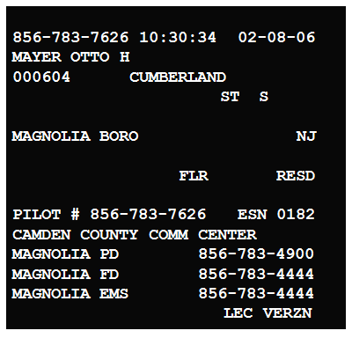
Reading the ALI Monitor
Standard Wire Line ALI
Notes:
This is the typical ALI screen for a wireline call.

Slide 63
Reading the ALI Monitor
32 Characters Wide
16 Lines High
Notes:
The ALI screen has 16 lines each with 32 characters. (In 1989 that was a lot of data). Each line is broken into sections and each section provides certain information.
Line 1 is used for “warning messages”. There are a number of these messages and they will appear when needed. They occupy spaces 1 to 31. Space 32 is not used as part of the display. It serves a different purpose as a command to move the next characters to the next line on the screen.
Line 2, spaces 1-12 is the callback phone number. Spaces 13-14 are blank to separate the data from spaces 15-22 which show the time the call is being answered at the PSAP. Space 23 is blank and spaces 24-31 show the current date.
Line 3, spaces 1-31 are the customer name. This can be a person or business. On wireless calls it will be used to show the name of the service provider not the customer, with a few wxceptions. There are some other uses that will be discussed later.
Line 4, spaces 1-6 are the street number. It is left-padded with zeros if the number is less than 6 digits. Space 7 is blank. Spaces 8-10 are the street # trail indicator and rarely used in New Jersey so they will be blank. Space 11 is blank. Spaces 12-14 are the street name directional prefix. This may be E indicating east or SW indicating south west for example. Space 15 is blank. Spaces 16-31 are the name of the street.
Line 5, spaces 1-22 can be used to continue the name of the street if needed. If not they are blank. Space 23 is blank. Spaces 24-27 are the street name suffix. Examples are “ST” for street, “AVE” for avenue and “HWY” for highway. Space 28 is blank. Spaces 29-31 are the street name directional suffix. Examples are “E” for east, “NW” for northwest and so on. On a wireless call these will indicate the direction the antenna receiving the call is pointing.
Line 6, spaces 1-20 are location details. This was used to describe the location of a phone in a remote area, such as a payphone. It was also used to identify a region or a neighborhood. This is rarely used and in most cases will be blank.
Line 7, spaces 1-28 are the community. This will be the name of one of the 565 municipalities in the state with the type of municipality included. Examples are “TWP” for township, “CITY” for city, “BORO” for borough and so on. Space 29 is blank. Spaces 30-31 are the state. Usually “NJ” but “XX” is used for wireless and “NT” for some VoIP.
Line 8, spaces 1-25 are the building. This can be used to identify a specific building in a complex by name, number or other method.
Line 9, spaces 1-5 are the unit indicator. This can identify an apartment, section, cubical etc. Space 12 is blank. Spaces 13-15 display “FLR” to indicate following characters will identify the floor the caller is on. Space 16 is blank. Spaces 17=21 are the floor number. Spaces 22-27 are blank. Spaces 28-31 are the class of service. This will indicate the type of phone service the subscriber has.
Line 10 is blank.
Line 11, spaces 1-5 display the “PILOT”. On wireless and some VoIP calls this will display “ESRD”. This will display the primary billing number of the account. In residential services it will be the same as the call back number. With a business account it may differ from the call back number. With a wireless or VoIP call it will be the number used to route the caller to the PSAP and is not be dialed. Space 6 is blank. Space 7 displays the character “#”. Space 8 is blank. Spaces 9-20 are the primary billing number. Spaces 21-23 are blank. Spaces 24-26 display “ESN” for emergency services number. Space 27 is blank. Spaces 28-31 are the 4-digit ESN number.
Line 12, spaces 1-31 are the name of the primary PSAP.
Line 13, spaces 1-23 are the name of the fixed transfer assigned to that ESN. Wireline calls will have the local police while wireless will have a nearby primary PSAP. Spaces 24-31 display a non-emergency telephone number for the agency named. When used to transfer a call it will use the network transfer number programed into the network.
Line 14, spaces 1-23 are the name of the fixed transfer assigned to that ESN. Wireline calls will have the local fire while wireless will have a nearby primary PSAP. Spaces 24-31 display a non-emergency telephone number for the agency named. When used to transfer a call it will use the network transfer number programed into the network.
Line 15, spaces 1-23 are the name of the fixed transfer assigned to that ESN. Wireline calls will have the local emergency medical while wireless will have a nearby primary PSAP. Spaces 24-31 display a non-emergency telephone number for the agency named. When used to transfer a call it will use the network transfer number programed into the network.
Line 16, spaces 1-20 are blank. Spaces 21-23 display “LEC” (local exchange carrier) which indicates the provider of the routing service. Space 24 is blank. Spaces 25-29 will be the ID of the provider of the LEC. These companies that correspond to these abbreviations are available on the NENA website in “Company ID”.

Slide 64
Line 2 Call Back Number, Time and Date
Line 8 Latitude, Longitude, Altitude
Line 7 Municipality & State
Line 9 UNIT, APT, FLR & Class of Service
Line 11 Main Billing Number & ESN
Line 16 Local Exchange Carrier
*CAUTION* PAY PHONE
856-435-9626 14:52:10 02-08-06
PORT AUTHORITY TRANSIT CORP
000200 BERLIN ROAD
R/O ENTR DWNSTRS
LINDENWOLD BORO NJ
BLDG LNDWLD STA CORNER BE
COIN
PILOT # 856-435-9626 ESN 0166
CAMDEN COUNTY COMM CENTER
LINDENWOLD PD 856-783-4900
LINDENWOLD FD 1 856-783-4444
LINDENWOLD EMS 856-783-4444
LEC VERZN
Line 9 UNC, % & Class of Service
856-858-7626 11:43:12 02-08-06
FLANAGAN ROBERT
000210 CRYSTAL LAKE AVE W
HADDON TWP NJ
APT 262-A FLR RESD
PILOT # 856-858-7626 ESN 1387
CAMDEN COUNTY COMM CENTER
HADDON TWP PD 856-783-4900
WESTMONT FD 856-783-4444
WESTMONT EMS 856-783-4444
LEC CAVLR
Line 8 Building Information
Line 1 Caution Message
Line 3 Customer Name
Lines 4 & 5 Address
Line 6 Locality
Line 10 Blank
Line 12 Primary PSAP
*WRLS PH1*
609-789-2345 09:20:34 02-08-05
VERIZON WIRELESS
0000000088 DENNISVILLE
RD NE
RADIUS 05 MILES
MIDDLE TWP XX
+039.073200 –074.492600
UNC: % WPH1
ESRD # 609-511-4000 ESN 5404
NJSP OUD-SOUTH COMM 4
F1=GS PKY BASS RVR 609 295-2031
F2=MIDDLE TWP PSAP 609 465-8700
F3=LOWER TWP PSAP 609 886-2711
LEC VRZWL
Lines 13-15 Selective Transfers
RESD
BUSN
BPBX
WRLS
WPH1
WPH2
VOIP
BOX
PIER
APT
SUITE
ROOM
UNIT
LOT
WING
*NO RECORD IN DATABASE*
*POSSIBLE TTY CALL*
*MOVE IN PROGRESS*
*OFF PREMISE EXTENSION*
3RD PARTY CONFERENCE*
*OUTGOING LINE ONLY*
*PBX CALL*
*CENTREX CALL*
*PAY PHONE*
*WRLS PH1*
*WRLS PH2 LAT/LONG NOT AVAILIBLE*
Notes:
Line 1 is used for “warning messages”. There are a number of these messages and they will appear when needed. They occupy spaces 1 to 31. Space 32 is not used as part of the display. I serves a different purpose as a command to move the next characters to the next line on the screen.
Line 2, spaces 1-12 is the callback phone number. Spaces 13-14 are blank to separate the data from spaces 15-22 which show the time the call is being answered at the PSAP. Space 23 is blank and spaces 24-31 show the current date.
Line 3, spaces 1-31 are the customer name. This can be a person or business. On wireless calls it will be used to show the name of the service provider not the customer, in most cases. There are some other uses that will be discussed later.
Line 4, spaces 1-6 are the street number. It is left-padded with zeros if the number is less than 6 digits. Space 7 is blank. Spaces 8-10 are the street # trail indicator and rarely used in New Jersey so they will be blank. Space 11 is blank. Spaces 12-14 are the street name directional prefix. This may be E indicating east or SW indicating south west for example. Space 15 is blank. Spaces 16-31 are the name of the street.
Line 5, spaces 1-22 can be used to continue the name of the street if needed. If not they are blank. Space 23 is blank. Spaces 24-27 are the street name suffix. Examples are “ST” for street, “AVE” for avenue and “HWY” for highway. Space 28 is blank. Spaces 29-31 are the street name directional suffix. Examples are “E” for east, “NW” for northwest and so on. On a wireless call these will indicate the direction the antenna receiving the call is pointing.
Line 6, spaces 1-20 are location details. This was used to describe the location of a phone in a remote area, such as a payphone. It was also used to identify a region or a neighborhood. This is rarely used and in most cases will be blank.
Line 7, spaces 1-28 are the community. This will be the name of one of the 565 municipalities in the state with the type of municipality included. Examples are “TWP” for township, “CITY” for city, “BORO” for borough and so on. Space 29 is blank. Spaces 30-31 are the state. Usually “NJ” but “XX” is used for wireless and “NT” for some VoIP.
Line 8, spaces 1-25 are the building. This can be used to identify a specific building in a complex by name, number or other method.
Line 9, spaces 1-5 are the unit indicator. This can identify an apartment, section, cubical etc. Space 12 is blank. Spaces 13-15 display “FLR” to indicate following characters will identify the floor the caller is on. Space 16 is blank. Spaces 17=21 are the floor number. Spaces 22-27 are blank. Spaces 28-31 are the class of service. This will indicate the type of phone service the subscriber has.
Line 10 is blank.
Line 11, spaces 1-5 display the “PILOT”. On wireless and some VoIP calls this will display “ESRD”. This will display the primary billing number of the account. In residential services it will be the same as the call back number. With a business account it may differ from the call back number. With a wireless or VoIP call it will be the number used to route the caller to the PSAP and is not be dialed. Space 6 is blank. Space 7 displays the character “#”. Space 8 is blank. Spaces 9-20 are the primary billing number. Spaces 21-23 are blank. Spaces 24-26 display “ESN” for emergency services number. Space 27 is blank. Spaces 28-31 are the 4-digit ESN number.
Line 12, spaces 1-31 are the name of the primary PSAP.
Line 13, spaces 1-23 are the name of the fixed transfer assigned to that ESN. Wireline calls will have the local police while wireless will have a nearby primary PSAP. Spaces 24-31 display a non-emergency telephone number for the agency named. When used to transfer a call it will use the network transfer number programed into the network.
Line 14, spaces 1-23 are the name of the fixed transfer assigned to that ESN. Wireline calls will have the local fire while wireless will have a nearby primary PSAP. Spaces 24-31 display a non-emergency telephone number for the agency named. When used to transfer a call it will use the network transfer number programed into the network.
Line 15, spaces 1-23 are the name of the fixed transfer assigned to that ESN. Wireline calls will have the local emergency medical while wireless will have a nearby primary PSAP. Spaces 24-31 display a non-emergency telephone number for the agency named. When used to transfer a call it will use the network transfer number programed into the network.
Line 16, spaces 1-20 are blank. Spaces 21-23 display “LEC” (local exchange carrier) which indicates the provider of the routing service. Space 24 is blank. Spaces 25-29 will be the ID of the provider of the LEC. These companies that correspond to these abbreviations are available on the NENA website in “Company ID”.

Slide 65
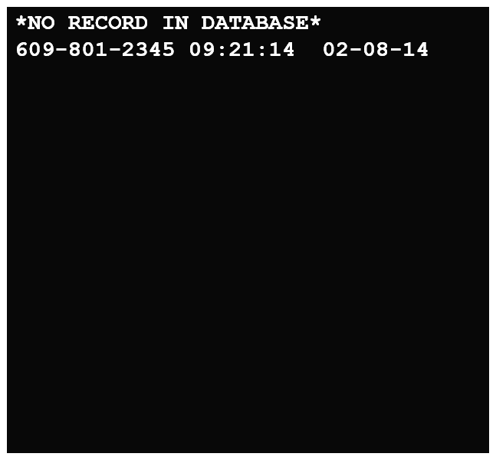
Reading the ALI Monitor
No Record Found
Notes:
There will be times when problems occur. The network is designed to default route a 9-1-1 call to a PSAP based on the municipality, county, telephone central office or state level based on the available information. If this happens the PSAP will be get the caller and the ALI screen will indicate the possible problem. In these cases the PSAP will be dependent on the information obtained from the caller only. After the call the PSAP must contact the 9-1-1 Customer Care Center or the entity indicated on the ALI screen to correct the problem.
A “NO RECORD IN DATABASE” message indicates contacting the CCC.

Slide 66
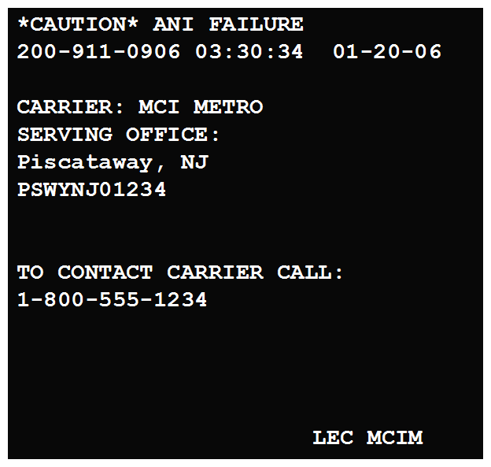
Reading the ALI Monitor
ANI Failure
Notes:
The message “CAUTION ANI FAILURE” offers the name and number to contact. When there is no name or number start with the Customer Care Center.

Slide 67
PSAP Inquiry Form
This form is used to alert the DMC or the telephone service provider of omissions or errors in the database.
The form should be faxed to the LEC responsible for the customer’s record or the Verizon DMC for no record found calls.
Notes:
PSAP Inquiry Form
When the ALI screen is complete but the information is wrong this should be reported to the LEC for correction. The computer based 9-1-1 equipment usually has an automatic reporting function that can be printed out and faxed or e-mailed to the LEC. For those without this capability there is the standard form that can be used.

Slide 68
PSAP Inquiry Form
Call Date: |  | Call Time: |  | LEC ID: |  | Test Call Actual Call
PSAP Name: |  |  |  | PSAP #: |  | County:
PSAP Tel.# |  | PSAP Fax# |  | PSAP Tkt# |  | Operator #
Reported Telephone # |  |  |  | CF# | [ ]
SECTION 1: Enter data exactly as displayed on ALI Monitor or attach print screen copy
Caution Msg: |  |  |  | Name:
Street # |  |  | Street Name:
Locality |  |  |  | Unit# | Flr# | Class Service:
Municipality |  |  |  | Bldg ID
Pilot # |  |  |  | ESN # | | | |
PSAP ID |  |  |  | Tel # [ ]
Police |  |  |  | Tel # [ ]
Fire |  |  |  | Tel # [ ]
EMS |  |  |  | Tel # [ ]
EMS |  |  |  | Tel # [ ]
Notes:
If using the paper form fill in all of the information that is wrong and what the correct information is. Attaching a copy of the ALI screen is recommended.

Slide 69
PSAP Inquiry Form
SECTION 2: Enter only data that is to be corrected, leave unaffected fields blank
Caution Msg: |  |  |  |  | Name:
Street # |  |  |  | Street Name:
Locality |  |  |  |  | Unit# | Flr# | Class Service:
Municipality |  |  |  |  | Bldg ID
Pilot # |  |  |  |  | ESN # | | | |
PSAP ID |  |  |  |  | Tel # [ ]
Police |  |  |  |  | Tel # [ ]
Fire |  |  |  |  | Tel # [ ]
EMS |  |  |  |  | Tel # [ ]
T | Findings tax ofc cust other |  |  | Order # |  | Database Updated No trouble found
E | Enter Corrected Data
L
C
O
 | ESN # |  |  |  | Remarks
A
C
T
I
O
N | Telephone Co Tracking #: |  |  |  | Date Closed |  | Initials
Signature Authorizing ESN / Agency Change:
Notes:
Many of the new computer based systems have a report writing feature that will allow the PSAP to create a form and fax or e-mail it to the carrier.

Slide 70
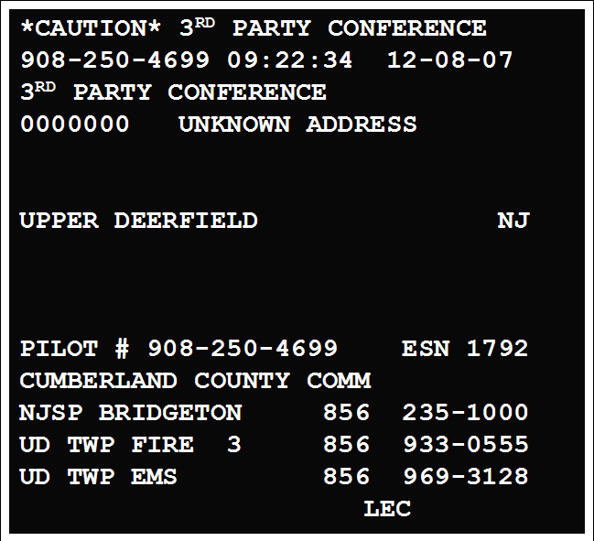
Reading the ALI Monitor
Wireline ALI screen
Special Circumstances
Notes:
When the decision was made to have a statewide 9-1-1 system it was thought that calls should come only from the people needing help. Companies that provided security services such as bugler alarms, fire alarms and medical alarms would have to call a direct number as 9-1-1 calls would only go to the PSAP serving the area where there monitoring station was located. Particularly in the case of automatic dialers that would call the local emergency service and paly a recorded message indicating the activation of an alarm.
There were services that could provide the customer with direct contact with an operator when these services activated and the operator would be able to ask questions of the subscriber. Because of this it was thought that there should be a way get into the system from outside of the local routing. Such a method already existed.
When a person dialed “O” in an emergency and got the telephone operator and the operator determined the location and nature of the problem they had the ability to transfer the caller to the primary PSAP using the “operator service “numbers. Each municipality in New Jersey was assigned one of these numbers and they could be used from outside of the state. The call would be sent into the 9-1-1 network and ring at the PSAP like any other 9-1-1 call. It wasn’t until the call was answered that the PSAP would see it was this type of transfer.
The warning line displays “*CAUTION* 3rd PARTY CONFRENCE”. The callback number will be 908-250-NNNN. The area code and exchange will always be 908-250 and each set of 4 digits will correspond to one of the municipalities in New Jersey. The address will be “0” and “UNKNOWN ADDRESS”. The municipality will be the one indicated by the caller. The ESN used will be the default one for the municipality so it may not be the correct one. This does not need correction as we are routing at the municipal level not the ESZ. Unfortunately there will be no usable caller information.
This has been offered to medical alarm services and vehicle telemetric services where they are able to put the caller in direct communication with the PSAP.

Slide 71
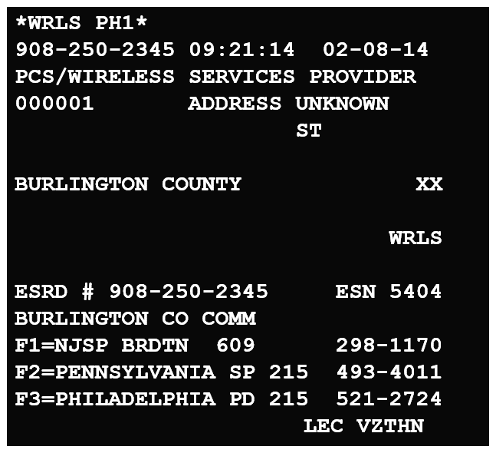
Reading the ALI Monitor
Wireless Default ALI
Notes:
Wireless Default ALI
Under some conditions the wireless carrier may not be able to determine the tower that is processing the 9-1-1 call. When this happens it may use the county level default routing. Each county has designated a PSAP that will service this function. When it occurs the ALI screen will be Phase I. The call back number will be 908-250-NNNN. This number is unique to a carrier and helps identify, along with the name field and the LEC which carrier is having the problem. The carrier should be contacted after the call to identify and correct the problem. Unless the caller is a telemarketer. Because the number is 908-250-NNNN it can be dialed from outside of New Jersey and if it is in the range of numbers being used it will ring at the PSAP. This will continue until these changes can be made with the FCC and these numbers can be added to the “do not call” list.

Slide 72
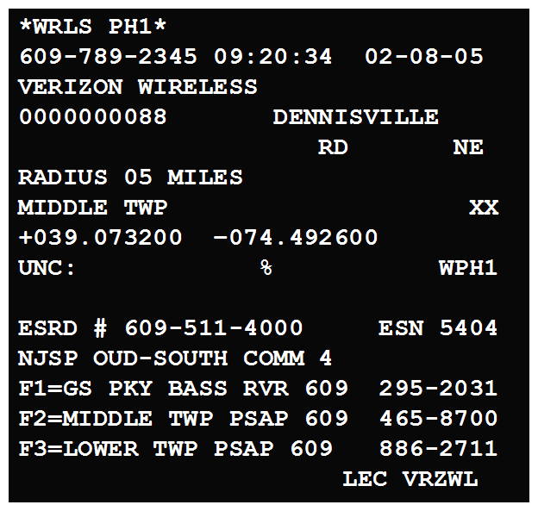
Reading the ALI Monitor
Wireless Phase 1
Notes:
Wireless Phase I
This ALI screen will only show the caller’s callback number. The location information is the cell tower. The PSAP can attempt a rebid but it is unlikely the call will become Phase II.

Slide 73
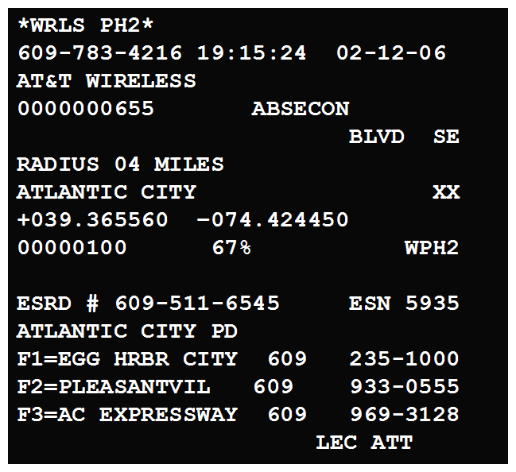
Reading the ALI Monitor
Wireless Phase 2
Notes:
Wireless Phase II
The ALI screen will still show the address of the cell tower but the latitude and longitude will be the estimated location of the caller, not the cell tower.

Slide 74
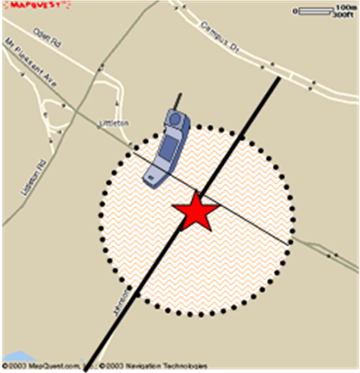


Uncertainty and Confidence Factors
Estimated Latitude and Longitude delivered to the PSAP
Caller’s actual location
Notes:
Uncertainty and Confidence Factors
The uncertainty field will the radius the network estimates the caller is in from the latitude and longitude offered. On a map this shows the area the caller is estimated to be in. The confidence is the percentage of accuracy the network has with this location.

Slide 75
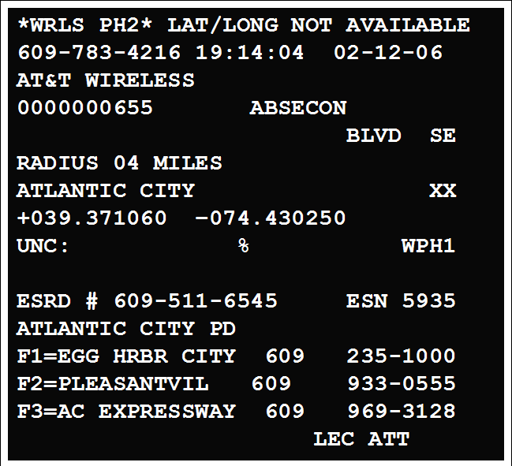
Reading the ALI Monitor
WPH 1 - WPH 2 Capable
Notes:
WPH1-WPH2 Capable
When the warning line is “*WRLS PH2 LAT/LONG NOT AVAILABLE*” it indicates that the call is capable of offering the estimated location but has not yet determined it with an acceptable degree of accuracy. If the calltaker waits a minimum of 20 seconds and attempts a rebid the information may be available. If this is done and the call is still not Phase II the calltaker should not attempt another rebid for a minimum of 20 seconds.

Slide 76
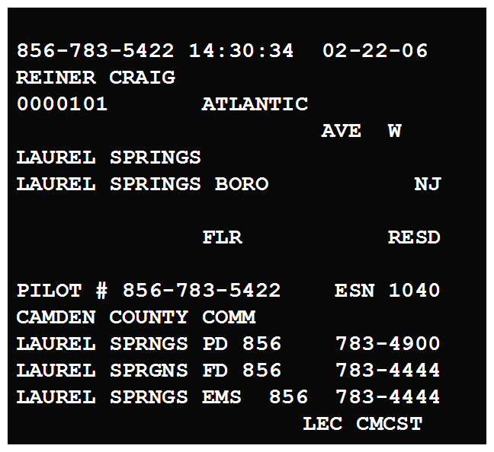
Reading the ALI Monitor
Stationary VoIP Screen
Notes:
Stationary VoIP Screen
The ALI screen will appear no different from a traditional wireline service. The only indicator is the name of the LEC provider.

Slide 77
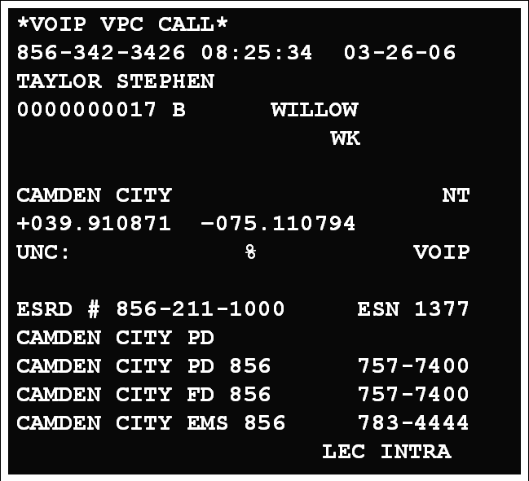
Reading the ALI Monitor
Nomadic VoIP with VPC ALI
Notes:
Nomadic VoIP with VPC ALI
This screen will combine element of wireline service and wireless. The subscriber’s name and address will appear. In addition the latitude and longitude for the address will also be displayed.
Routing for these may be done by using the traditional MSAG as used in wireline or the latitude and longitude for the address similar to that used in wireless routing. The difference is that the location is used for routing not a cell tower.
Most VoIP services require the customer to input their location information into the service provider’s database. This can cause problems if the customer moves and does not make the proper changes. Sometimes the service that identifies the municipality where the address is located can err by using the name of the region or post office when deciding where to route the call.
It appears that stationary VoIP providers are making use of the same method as the nomadic providers.

Slide 78
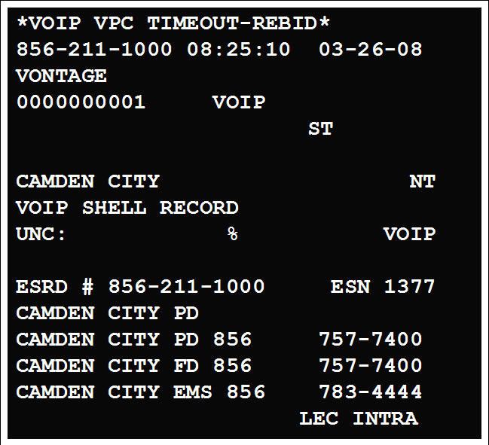
Reading the ALI Monitor
Nomadic VoIP Default Screen
Notes:
Because the method is similar to that used to route wireless it was thought that there may be a delay in obtaining the customer information so default screens where developed to function like wireless calls that are capable of Phase II but are offering Phase I. These will include the instructions to rebid in the warning line. A rebid can be done on any 9-1-1 call. This rarely occurs as the data is stored in a database and not something that has to be determined on short notice like wireless location.

Slide 79
Reading the ALI Monitor
VoIP Default Routing Screen
Utilizing the Operator Service Number
Notes:
The “3RD PARTY CONFERENCE CALL” may appear when a VoIP call has routed to a PSAP outside of the state. The PSAP can use them to transfer the caller into the NJ 9-1-1 network the same way the telephone company operator can. These numbers have been placed on the NENA 9-1-1 PSAP Registry website for this purpose. They are meant to be used by other PSAPs or by the VoIP carriers who maintain a network operations center that receives 9-1-1 calls that their service cannot for any reason properly route.

Slide 80
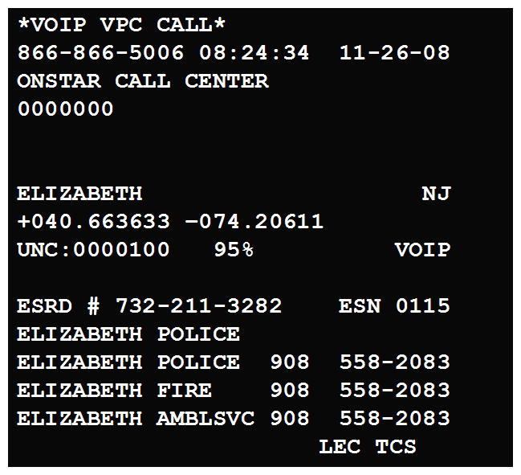
Reading the ALI Monitor
Wireless/VoIP Combination
Notes:
VoIP is being used by GM OnStar. The control centers can now connect subscribers to the PSAP instead of using “3RD PARTY CONFERENCE”. This allows OnStar to send some useful information such as their callback number, identifying them as the sender and the latitude and longitude of the vehicle in addition to connecting the customer to the PSAP.

Slide 81
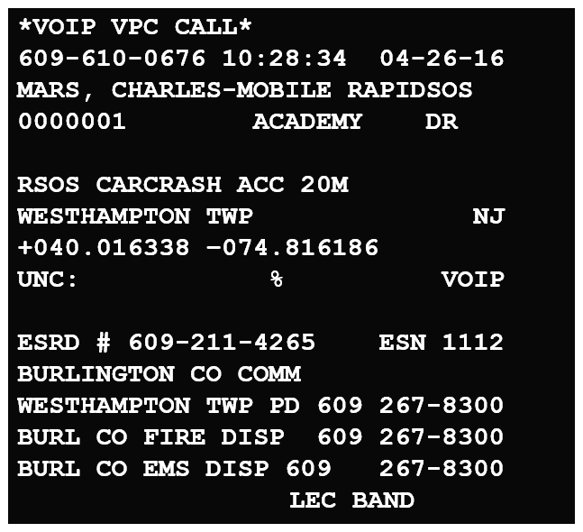
Reading the ALI Monitor
Wireless/VoIP Combination
Notes:
Today there is an “app” for everything, even 9-1-1. One such app when used to call 9-1-1 will offer you a map showing your location and offering an address. Meanwhile the app is placing a call to 9-1-1 but not using the wireless network. It sends the call as a VoIP call and is delivered to the PSAP with the address offered to the caller. The app also has categories to identify a police, fire, medical or vehicle collision. These are selected to start the call and the choice will be displayed on the ALI screen. It will also display the name of the person registered on the cell phone and the name of the app. If the caller cannot speak the app will use a computer generated voice to relay the information based on the information provided. The call is made with a wireless device and the “Rapid SOS” app.

Slide 82
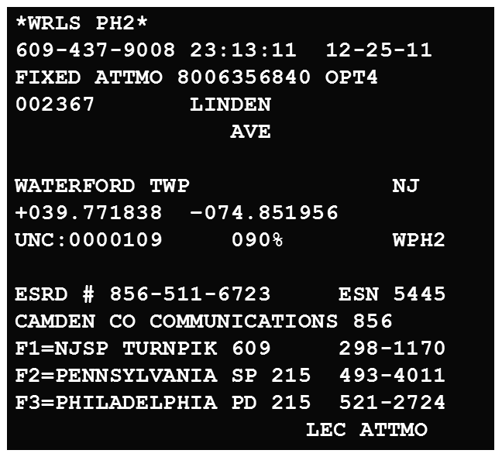
Reading the ALI Monitor
Wireless/VoIP Combination
Notes:
Another wireless/VoIP combination is the AT&T service that allows the customer to improve wireless coverage in their home by adding a device that will connect to the internet and act as a cell tower within the home. The customer must “pair” the devices that will use this service. Some of these devices will process 9-1-1 calls from a “non-paired” device if it is within range.
In this example the device is identified by the name “FIXED ATTMO 8006356480 OPT4”. This means this is a small cell site at the customer’s home. The 8006356480 is (800) 635-6480, the number for AT&T security. “OPT4: is option 4 that you would select to talk to them to obtain customer information.
The address displayed is the location of the device and the customer address, not a cell tower. Because the coverage area of the device is so small the caller should be at or near that address.

Slide 83
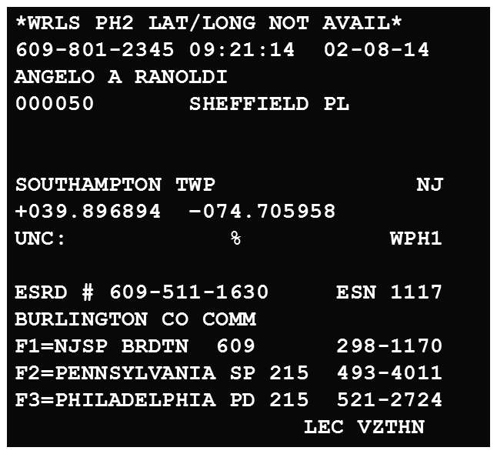
Reading the ALI Monitor
Wireless/VoIP Combination
Notes:
This is an example of the same service offered by Verizon. The antenna is located at the customers residence and the devices using it must be “paired”. In this case the customer’s name is displayed instead of Verizon. The address and latitude and longitude are the customer’s. It is a wireless Phase I call with an accurate address since the “cell tower” is located at the customer’s location.
Notice that the ESN used for routing is the wireline not the wireless one. So maybe it is VoIP?

Slide 84
Reading the ALI Monitor
What is the most reliable way to determine if the location offered is the cell tower or the caller?
If the information on the ALI screen needs to be corrected where is the correction sent?

Slide 85
Text to 9-1-1
Texting to 9-1-1 was intended to be offered in the “next generation 9-1-1”. This would include video, audio and MMS messaging. As this is not in the near future it was decided to go for an “interim” solution that would provide SMS texting now without additional equipment or cost to the PSAPs.
SMS does not allow sending pictures, video, recorded messages or special characters. These are considered MMS messages and cannot be used to text 9-1-1 at this time.
Notes:
The project known as “Next Generation 9-1-1” has been on the planning stages for some time. While technology has progressed the 9-1-1 network is still a 1980’s based network. The new features such as texting would be incorporated into NextGen.
However the public desire for the ability to send text messages to 9-1-1 influenced the Federal Communications Commission to make the providers of this service come up with a way to do this prior to the implementation of NexGen 9-1-1.
Once the providers were ready it was up to the PSAPs to determine if they would receive text messages to 9-1-1. The New Jersey Public Safety Communications Commission determined that this would be made available and tasked OETS with implementing the service statewide.
It was decided to follow a path similar to that used with the deployment of wireless 9-1-1. Each county coordinator was involved in selecting one PSAP that would receive all text messages sent to 9-1-1 within its borders. The PSAP would dispatch or relay the information to the appropriate PSAP/PSDP for dispatch. There would be no ability to transfer the text message to another PSAP.

Slide 86
Text to 9-1-1
Routing the text messages is similar to routing cell phone calls. Depending on the carrier, the text message will be routed based on the centroid of the cell towers coverage area or it may be routed based on the approximate location of the device being used. In each case the location used will be plotted on a map of the state
Notes:
Routing would be similar to wireless using the centroid of the cell tower coverage area or the actual location of the device. The latitude and longitude would be offered to the PSAP along with the text message. Only SMS messages would be sent to the PSAP. MMS messages with sound, video and other data could not be sent over this system. They would be in the NextGen network. This service would be an interim solution.
The PSAP were to decide which of the three methods that are available they would use. The first method would convert the text message to baudot code and send it to the PSAP over the existing 9-1-1 trunks in the same manner as a TTY/TDD machine. The second would require the PSAP to have a computer log onto a secure website that would then send a text message similar to the format used on most cell phones. The website would also include a popup map that would display the location being offered. The third method would require a dedicated connection to the service provider and 9-1-1 equipment that could interface with the service provider. This would be NextGen service and incur a significant cost.

Slide 87
Text to 9-1-1
Text messages can be delivered to the PSAP using the existing 9-1-1 phone circuits or over the internet. Both have been chosen for use in this project.
Notes:
A text message over the existing network would come in to the PSAP like a typical 9-1-1 call. Once answered the baudot sounds would activate the TDD function and messages would be exchanged in the same fashion as a TDD call. The call may be Phase I or Phase II so rebidding is an option.

Slide 88
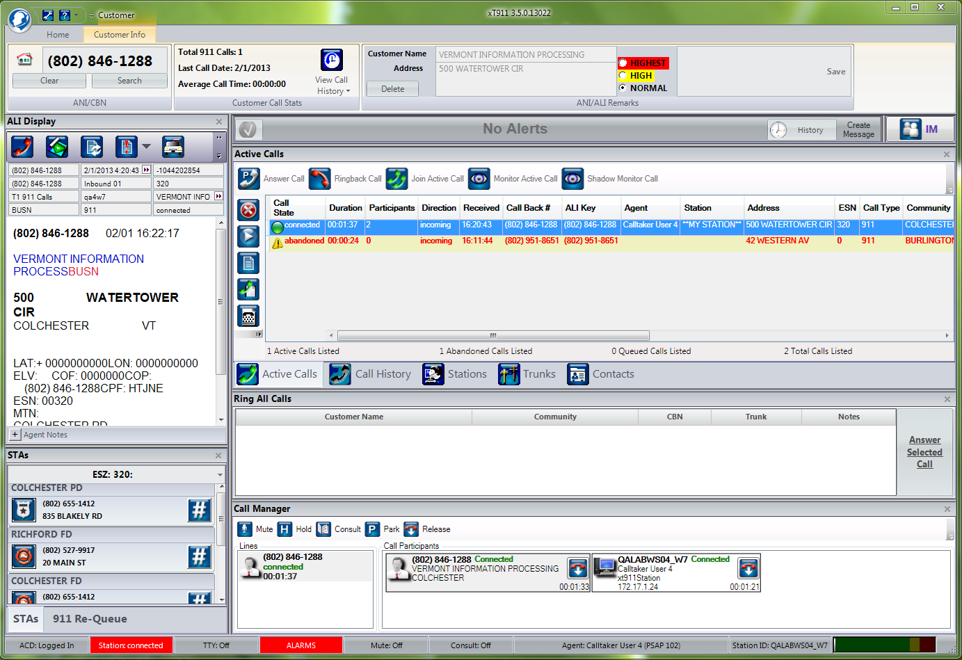
Text to 9-1-1
Text over Existing 9-1-1 Network
Notes:
The exchange of text messages will appear on the computer screen the same way a landline TTY call would. The service provider will also add location information in the form of latitude and longitude which may appear different from the information on the ALI screen.

Slide 89
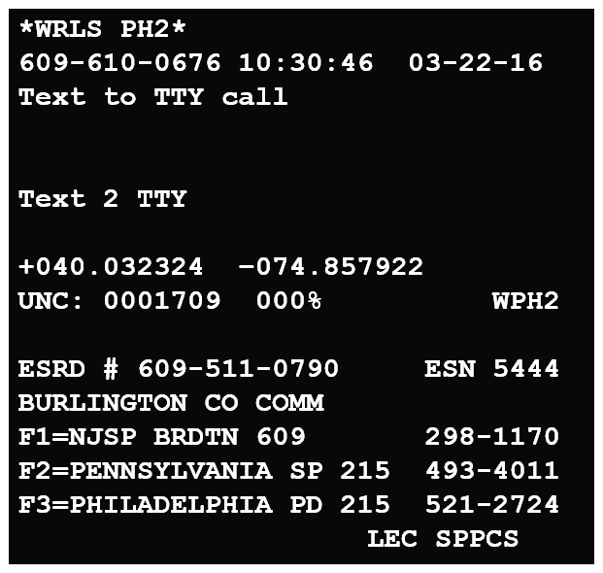
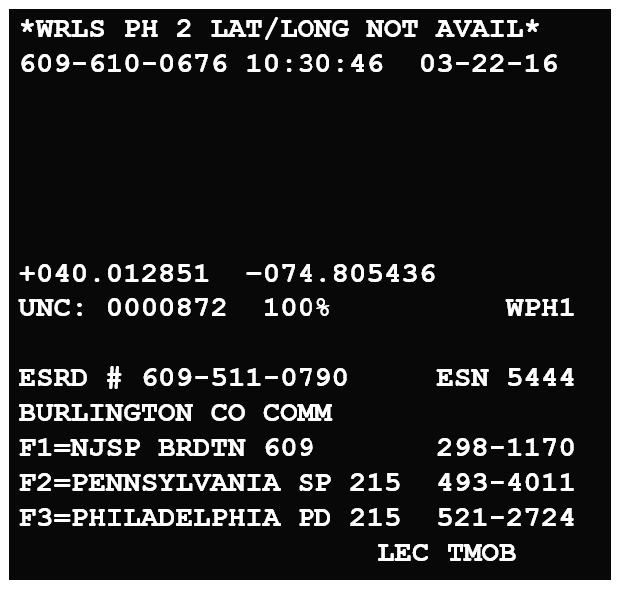
Text to 9-1-1
Text over Existing 9-1-1 Network
Notes:
The ALI screen appears different as there will be no customer name although some carriers will indicate that this is a text to TTY call. Nor will there be the address of the cell tower. The latitude and longitude may be the location of the person sending the text or the centroid of the cell tower.

Slide 90
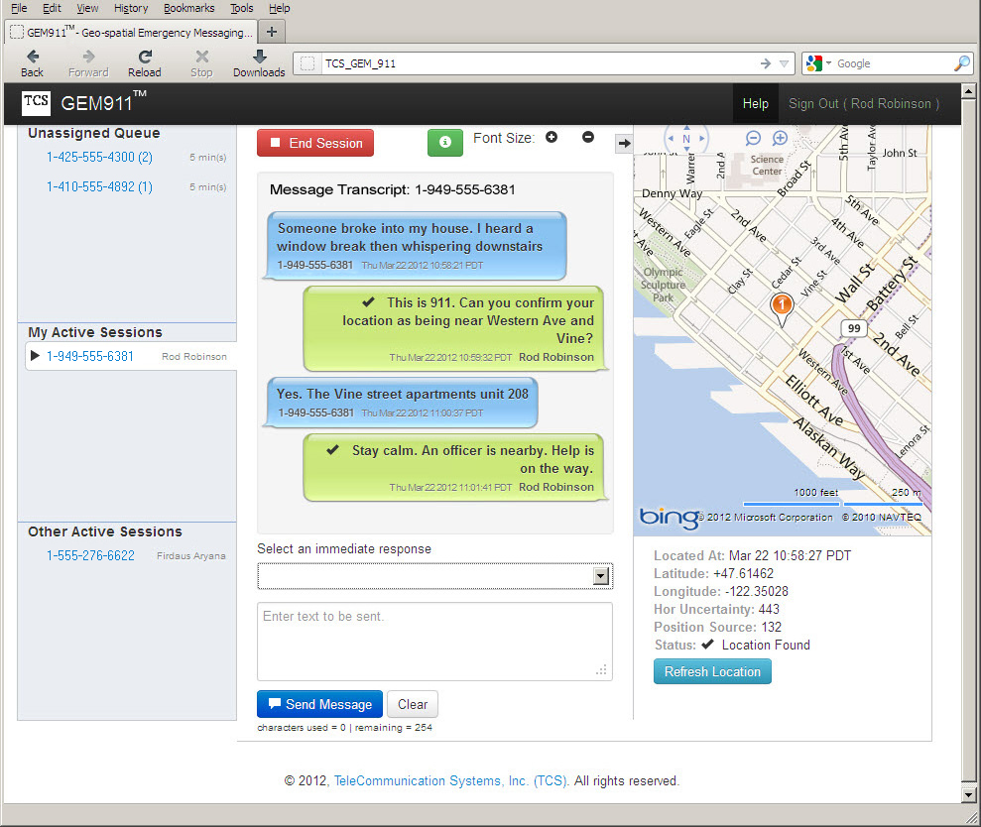
Text to 9-1-1
Text over Internet
Notes:
The internet based method looks like texting on a cell phone with a few extras. There is a map showing the offered location and the calltaker can see other text sessions going on in the PSAP.

Slide 91
Text to 9-1-1
What does a PSAP have to do to prepare to receive Text to 9-1-1 messages?
If the sender stops replying to the PSAP what should they do?

Slide 92
Next Generation 9-1-1
Will be an IP based network
Allow text messages, instant messaging and other media
Will facilitate and simplify wide-range transfer of information (beyond the state boundaries).
Notes:
Next Generation 9-1-1
New Jersey is at the beginning of the process that will replace the existing 9-1-1 network with an IP based one that promises to offer better version of present services and many additional services to aid public safety. It will be much more complex than the old phone wire system and involve a much larger number of components. This is going to require a great deal of planning may a large number of people from all aspects of the emergency services. PSAPs and PSDPs are only a part of this effort and should make every effort to become involved in the planning and implementation while it is stil in these early stages.

Slide 93
Sample ALI Screens
Notes:
Call transferred from out-of-state using the “operator service” number for Upper Deerfield.

Slide 94
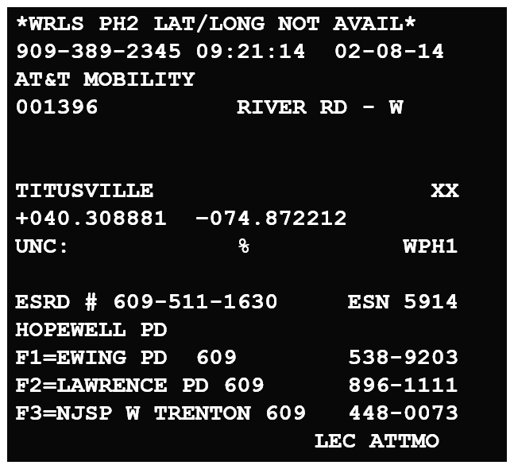
Sample ALI Screens
Notes:
Wireless call, Phase 1 Latitude and Longitude are those of the cell tower. Rebid to receive caller location. Also note municipality name is NOT that of an actual town or city.

Slide 95
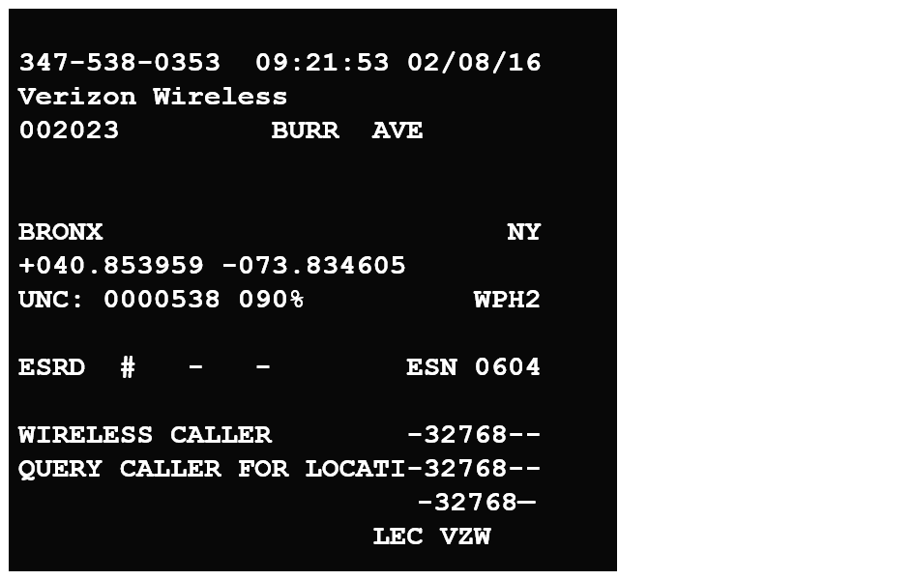
Sample ALI Screens
Notes:
Call was received by New York City and transferred to a PSAP in New Jersey. The Latitude and Longitude will be that of the caller. NYC does not use transfers so the lower part of the screen reminds them to verify the location.

Slide 96
Sample ALI Screens
*WRLS PH2*
609-610-0676 10:30:46 03-22-16
Text to TTY call
Text 2 TTY
+040.032324 –074.857922
UNC: 0001709 000% WPH2
ESRD # 609-511-0790 ESN 5444
BURLINGTON CO COMM
F1=NJSP BRDTN 609 298-1170
F2=PENNSYLVANIA SP 215 493-4011
F3=PHILADELPHIA PD 215 521-2724
LEC SPPCS
Notes:
Text to 9-1-1 sent to a PSAP using TDD/TTY for receiving text messages.

Slide 97
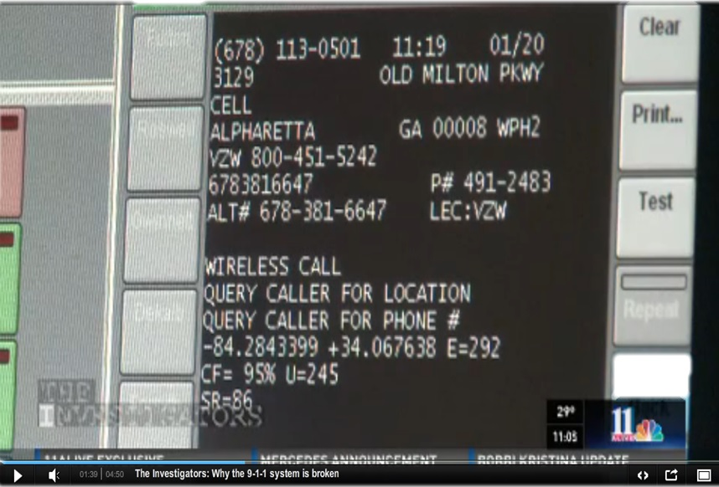
Sample ALI Screens
Notes:
Example of an ALI screen fron Georga

Slide 98
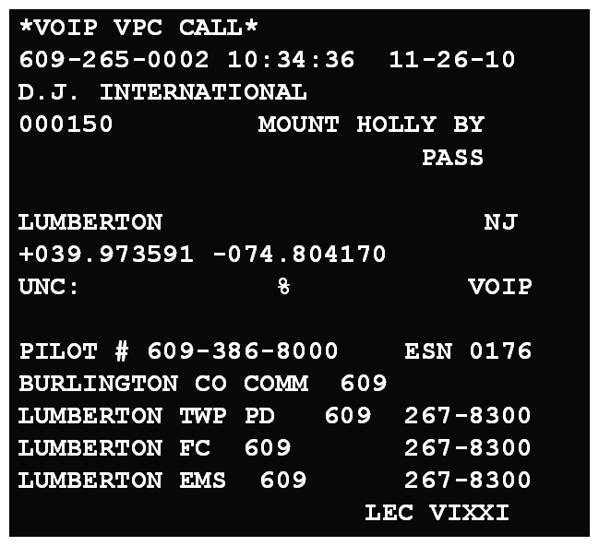
Sample ALI Screens
Notes:
Example of a VoIP call where customer has all extensions connected to a single location. The server is in New Jersey but the call was made from an office in Florida.

Slide 99
Sample ALI Screens
Notes:
A 9-1-1 call made with a cell phone relayed through a mico cell site at the customer’s home. The address of the cell tower is the location that the call is being made from inside or near the house. The “FIXED ATTMO 8006356840 OPT4” in the customer name field is the phone number and option for AT&T Security. It also indicates that this is an in-home cell site.

